Slide 1
DURABOOK U11I
INTRODUCTION
DURABOOK MARKETING DIVISION

Slide 2
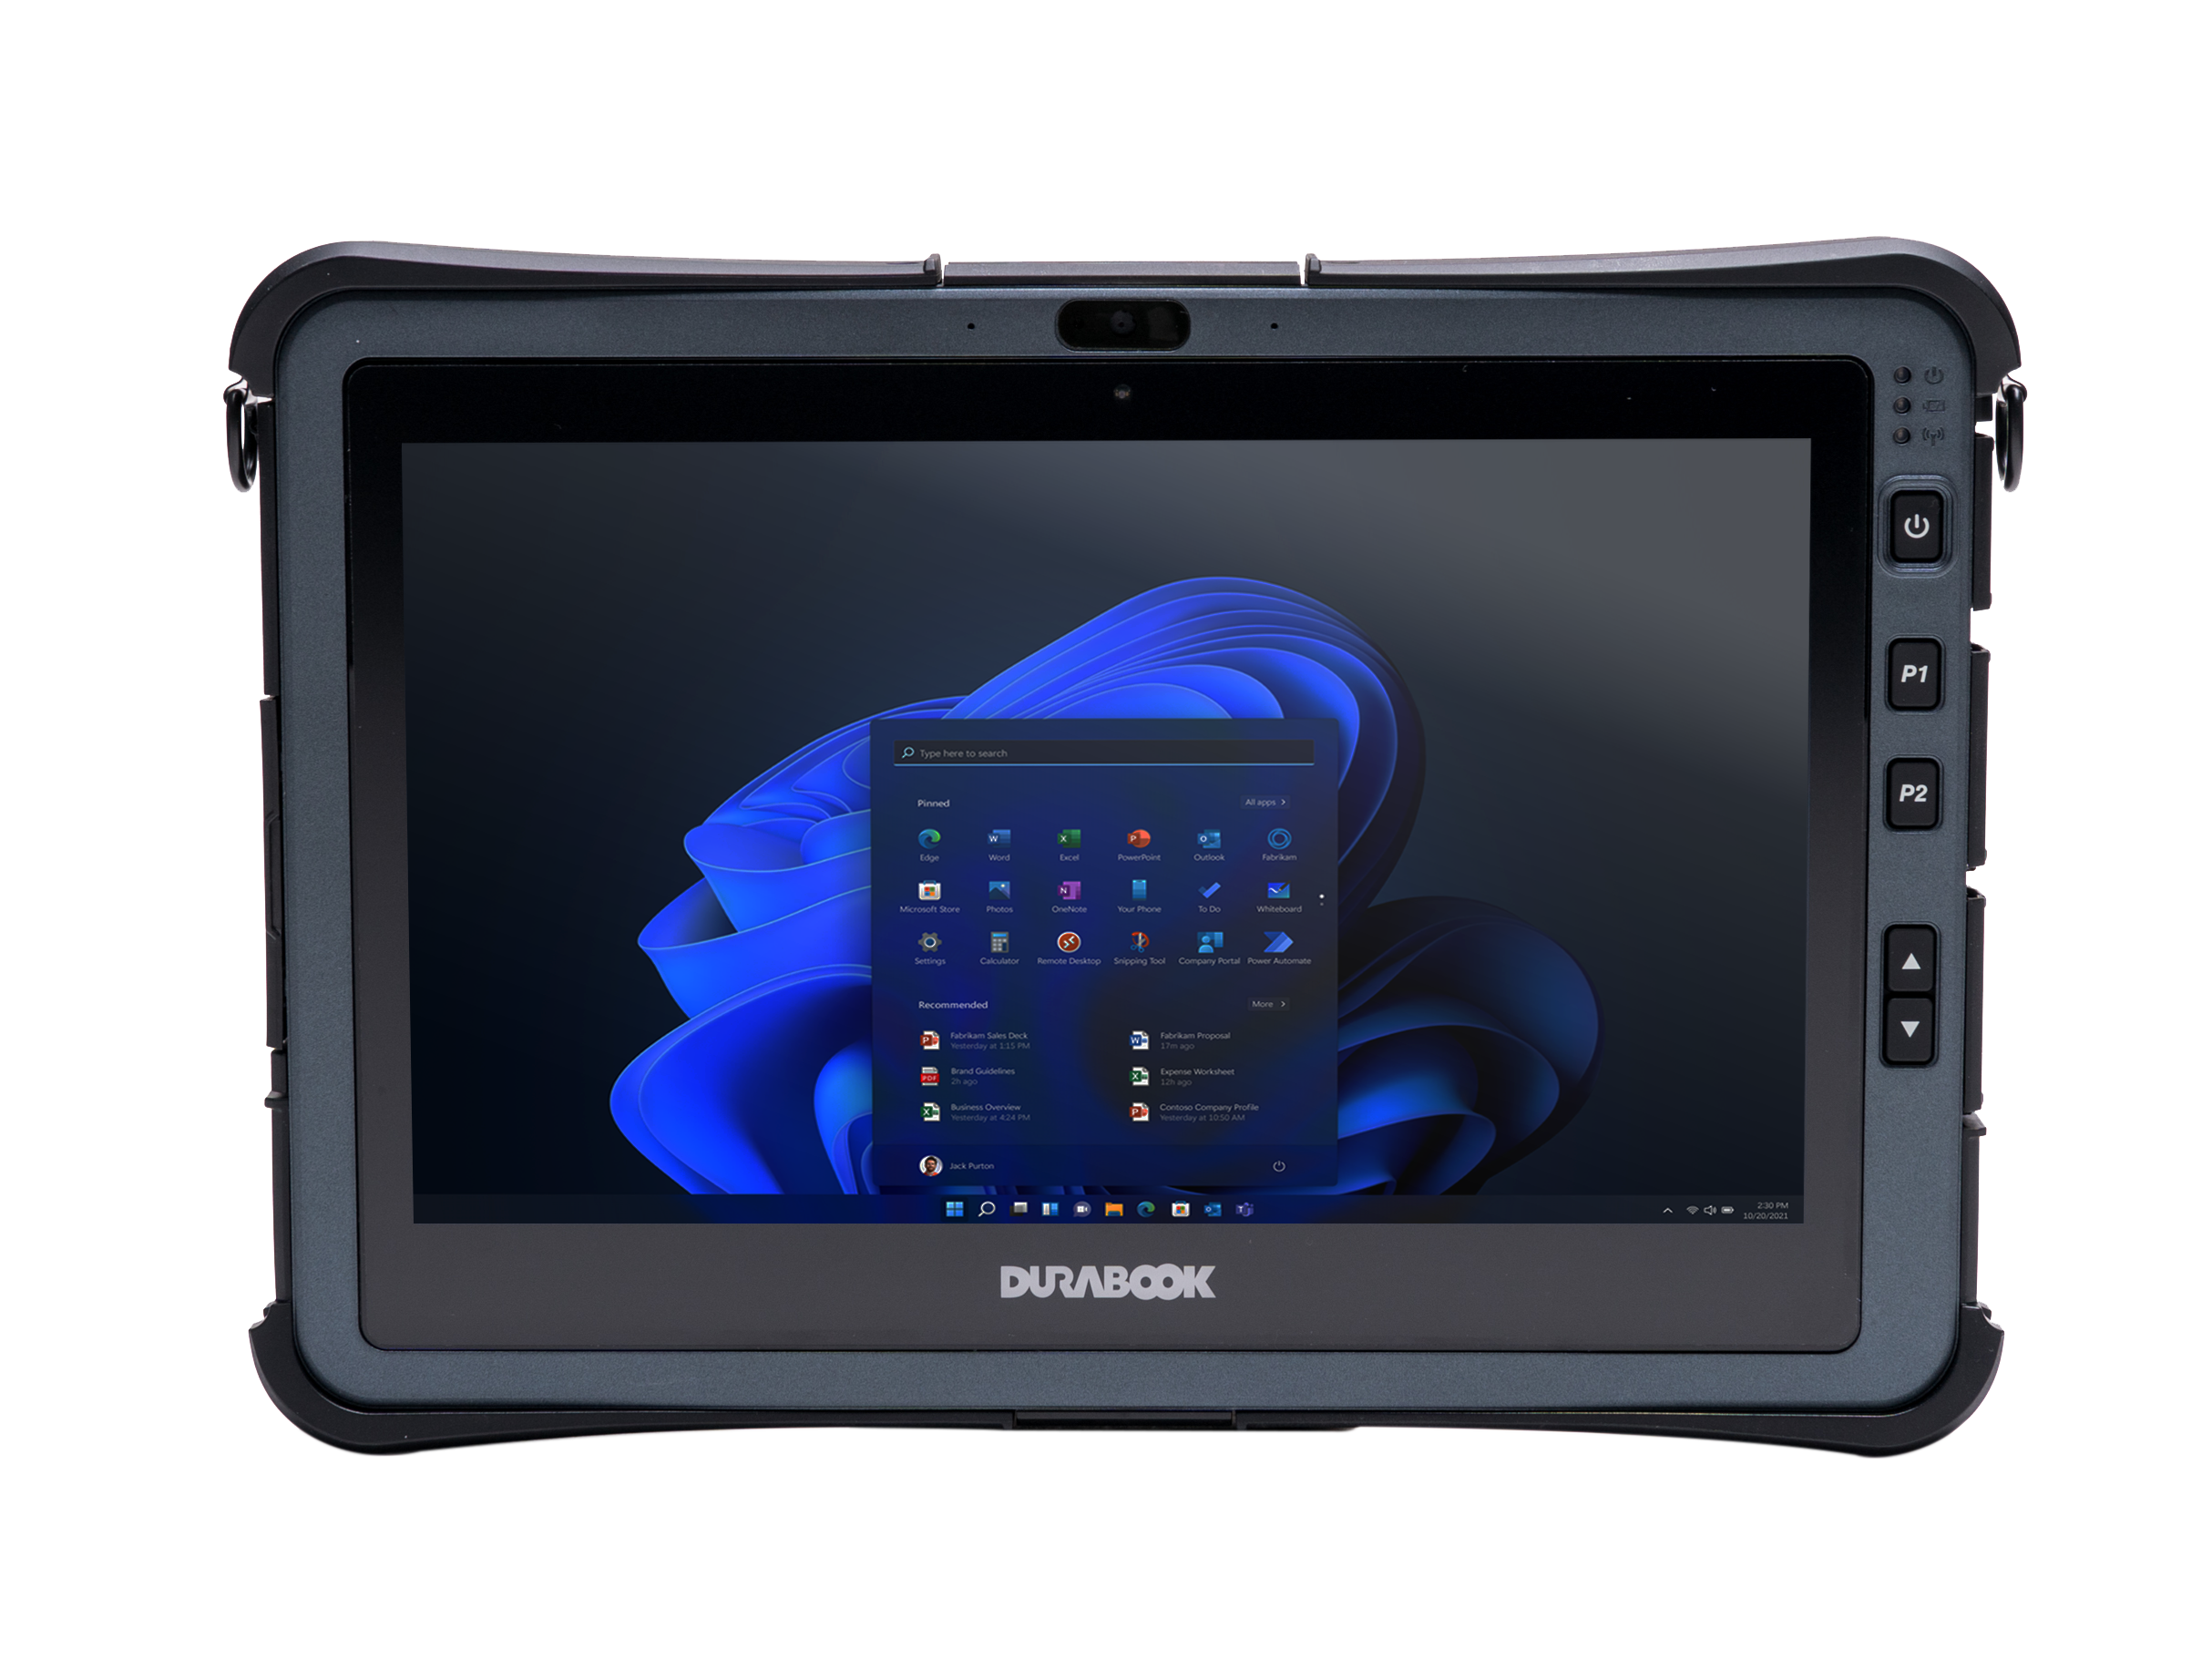
UNIQUE SELLING PROPOSITION
Revolutionary Computing Power
Unrivalled Viewing Quality
Utmost
Versatility
Rock-solid Design yet Fanless
12th Intel® Core™ CPUs
Thunderbolt 4
Quick release NVMe
SSD storage
Long-lasting battery life and hot-swappable battery
COOLFINITY™ fanless design
IP 66 and 6’ drop
MIL-STD-810H & 461G
ANSI/UL C1D2
Wide range temperature
(-20°C to 60°C)
11.6” FHD with DynaVue® technology and up to 1000 nits
4 touch modes, optional with digitizer
4G LTE/5G solution
Battery charging protection
Variety of I/O interfaces
Endless expansion options via expansion modules

Slide 3
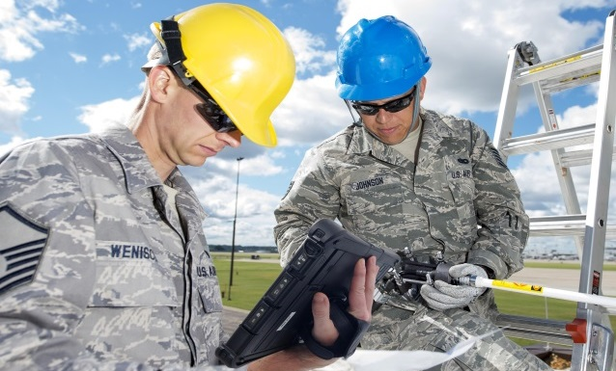

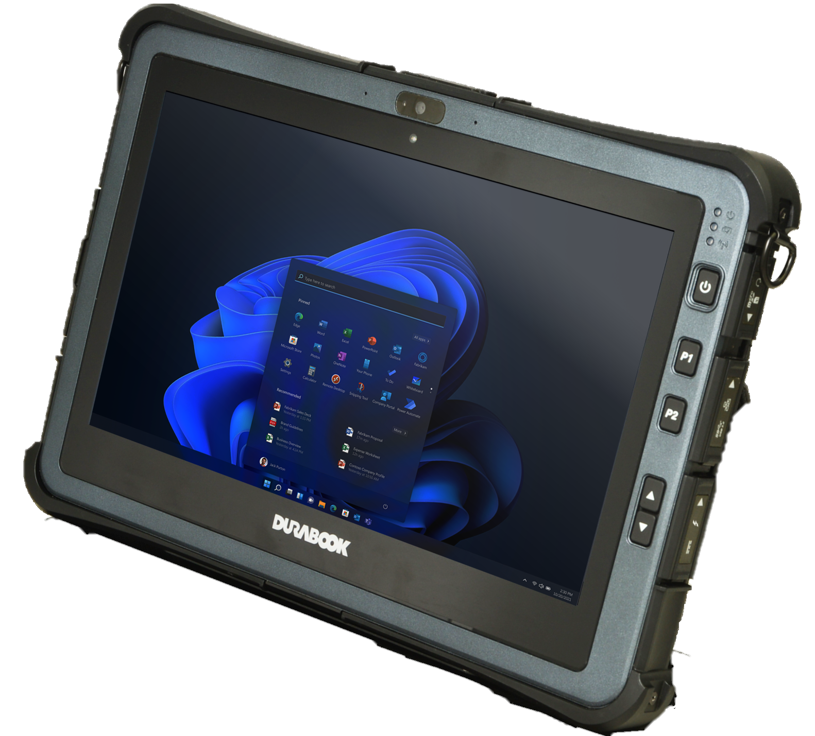


TARGETS & APPLICATIONS
Applications
Assets Management
Diagnostic and Maintenance
Working Manual Viewing
Ticketing
Field Services
MILITARY
PUBLIC SAFETY
PROFESSIONAL SERVICE
UTILITIES

Slide 4

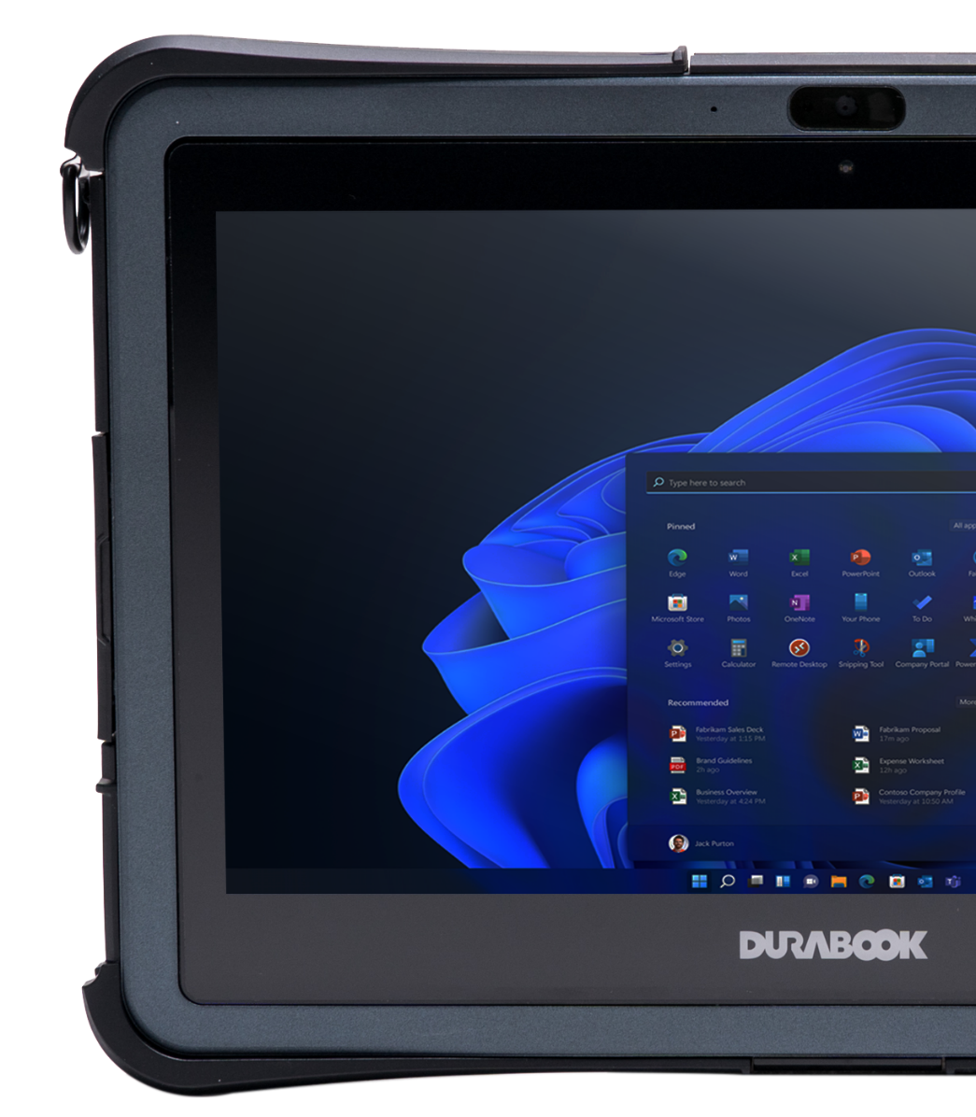

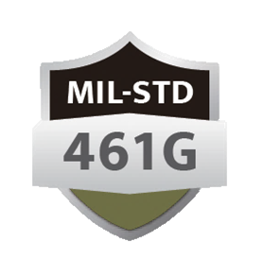






U11I FEATURES HIGHLIGHT
MOST POWERFUL FANLESS FULLY RUGGED in Its Class
12th Gen. Intel® Core processors with vPro™.
11.6” FHD (1920 x1080) 1000 nits touch sunlight readable display.
COOLFINITY™ fanless thermal design.
LPDDR4x memory up to 32GB.
Quick-release NVMe SSD storage.
Battery Charging Protection technology.
Integrated smart card/CAC reader (optional).
Hot-swappable battery design (optional).

Slide 5
COMPUTING POWER
12th Generation ALDER LAKE CPU
The 12th Generation Intel Alder Lake is up to 225% quicker than the 10th Generation.
 | Intel® Core i7-1250U (12 Gen) | Intel® Core i5-1230U (12 Gen) | Intel® Core i7-10510Y (10 Gen) | Intel® Core i5-10210Y (10 Gen)
Turbo Speed | Up to 4.7 GHz | Up to 4.4 GHz | Up to 4.5 GHz | Up to 4.0 GHz
# of Core | 2P+8E -Cored | 2P+8E-Cored | 4 -Cored | 4 -Cored
TDP | 9 W | 9 W | 7 W | 7 W
Cache | 12 MB | 12 MB | 8 MB | 6 MB
CPU Mark | 11,000 | 9,448 | 6,000 | 4,500
Source: Tested by PassMark

Slide 6

CPU PERFORMANCE
12th Generation ALDER LAKE CPU
The 12th Intel® UP4-Series CPU only takes 9W power consumption compared to 15W. The performance per watt is 276% better than other brands.
DURABOOK 12th gen U-Series CPU is unbeaten solution for 11” mobile tablets.
Performance per Watt
Processor | CPU Performance | Performance per Watt
Core i5-1230U (9W) (DURABOOK U11I) | 9,448 | 1,049
Core i5-10310U (15W) (Market Solution) | 6,500 | 433
1049
433
7372

Slide 7

COOLFINITY™ THERMAL PERFORMANCE
The 12th Intel® UP4-Series processor is the best solution for mobile tablet platforms.
The low power consumption design, powered by its better thermal management, guarantees stable system performance under harsh environments.
There is no CPU-throttling when the temperature goes higher.
CPU throttling to 19% because of heat.
>30℃

Slide 8
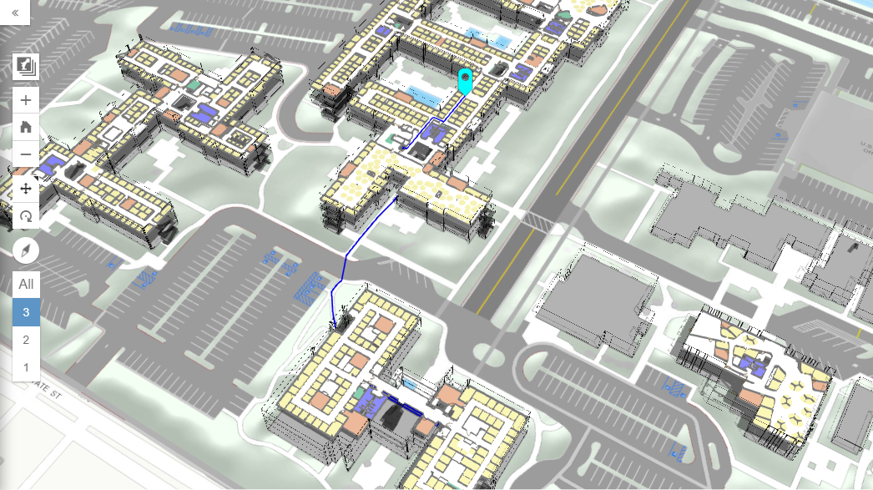
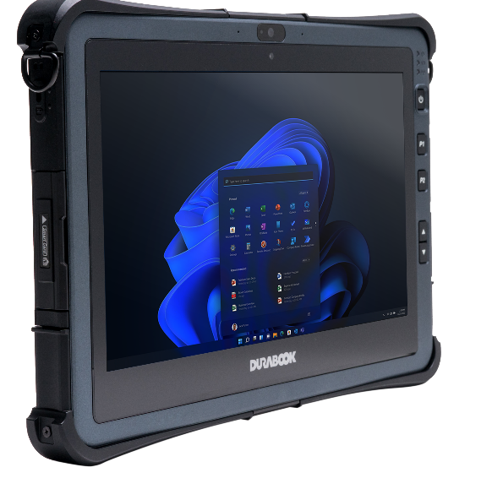

GRAPHIC PERFORMANCE
Intel® Iris Xe Graphics
The U11I comes with Intel® Iris Xe Graphics clocked 150 MHz higher than UHD results in 2.5x faster 3D effective speed - Better Than Enough in daily usage.
Source: PassMark

Slide 9


MAXIMUM CONNECTIVITY
INTEL® WI-FI 6E AX211
With ultra high-speed data transmitting capability, all the information are instantly synchronized and fed back to the data center.
Intel® Wi-Fi 6E AX211 with max. speed of 9.6Gbps is 5x faster than
AC 9260 with max. speed only 1.73Gbps.
Bluetooth® V5.3 bandwidth is 1.5x greater than v5.0, which is capable connecting multiple devices at once.
Brand | Wireless Lan | Bluetooth | Emission Speed | Effective Range
Durabook U11I New | 6E AX211 | V5.3 | 3.0 MB/s | Max 300 meters
Market Solution P | AX201 | V5.1 | 2.0 MB/s | Max 240 meters
Durabook U11I | AC9260 | V5.0 | 2.0MB/s | Max 240 meters

Slide 10

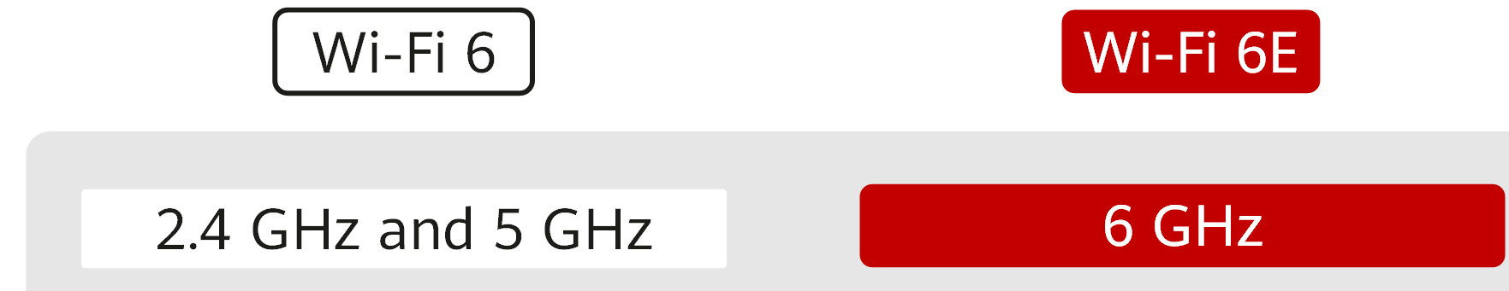
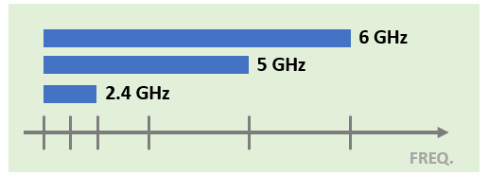



WI-FI 6E NEXT GENETATION CONNECTIVITY
Wi-Fi 6 refers to the sixth-generation wireless network technology.
The transmission rate of Wi-Fi 6 is 872.7x that of Wi-Fi 1. Except for rate, the Wi-Fi 6 rely on three technological innovations: faster, safer and more power saving.
Wi-Fi 6E brings Wi-Fi® into 6 GHz
Wi-Fi 6
Wi-Fi 6E
Frequency
2.4Ghz and 5Ghz
6 GHz
(2.4Ghz, 5Ghz supported)
Features
More, contiguous spectrum
Wider channels
Less interference

Slide 11

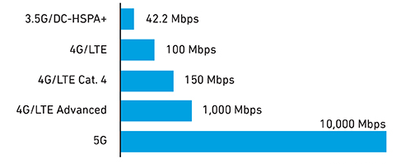
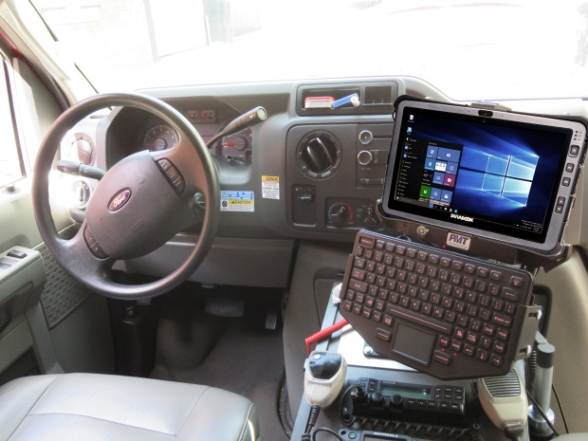


SEAMLESS CONNECTIVITY
Advanced wireless capabilities include cellular options of 4G LTE or 5G.
5G mobile connectivity offers ultrafast data transfer speed over previous generations of mobile networks, which is 100x fast than 4G LTE. Providing always-on high-speed connectivity for workers in the field with improved productivity anytime, anywhere.
Downlink Speeds by Technical Generation
GOVERNMENT SECTOR
U11I designed with u-blox NEO M9N module to provide high GPS accuracy.
And more, featured by RF Tri-pass-through (WIFI, WWAN, GPS), in-field professionals can connect to the remote database in real time.

Slide 12


VIEW EVERY DETAIL
THE NEW GENERATION OF DYNAVUE TECHNOLOGY
Default with 11.6” FHD (1920x1080) display
Optional with 1000 nits DynaVue® sunlight readable display and digitizer
The new DynaVue® light-filtering technology provides a high contrast ratio (CR) to eliminate reflection and deliver the best clarity.
High Brightness
Light Filtering Technology
DynaVue®
Increased Clarity &
Wider Viewing Angle

Slide 13
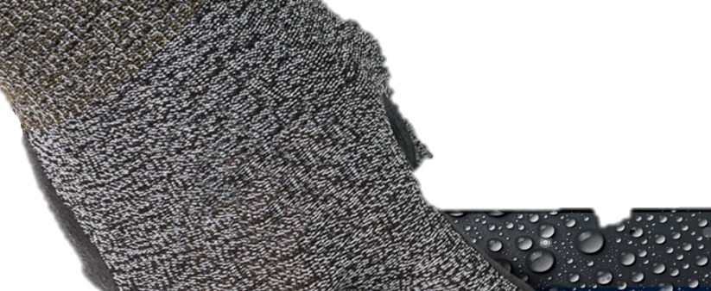

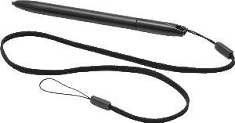




TOUCH IN AND OUT
4 touch mode and optional WITH Digitizer solution
Slim & light for seamless input
Stylus
U11I comes with a slim stylus as standard, a more precise alternative to your fingertips.
It allows you to easily control and navigate your tablet. A stylus can provide increased accuracy and deliver more pristine linework than that of your fingertip.
4 touch modes: glove, stylus, water & finger mode.

Slide 14



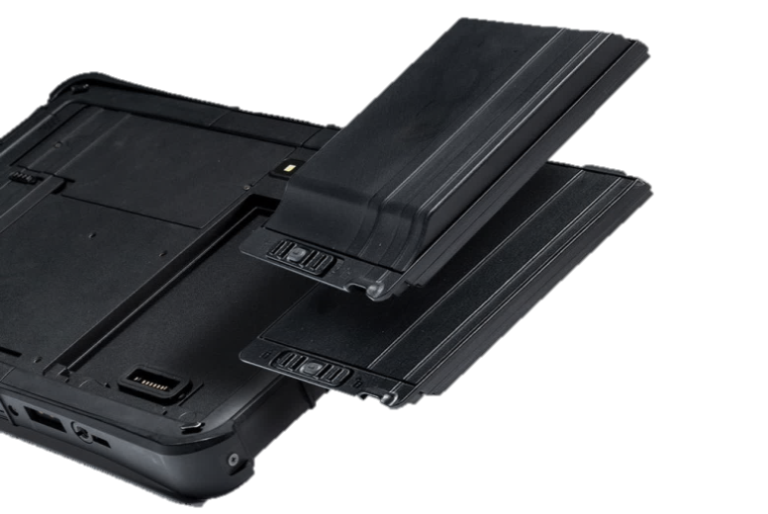
MARKET LEADER FOR POWER SUPPLY
The U11I is the market leader on power supply with up to 20 hours per single battery. Additionally, the U11I supports up to 5 mins swap-time for field professionals with no downtime for battery swaps.
Battery Life
Up to 20 hrs
Durabook U11I Hi-Cap Battery
U11I Hi-Cap Battery
Up to 12 hrs
With an optional 9,600 mAh Hi-Cap battery, field workers can work all-day long without changing battery in hazardous environments.
Market Solution D&G
9.5 hrs
Market Solution Z
Market Solution P

Slide 15
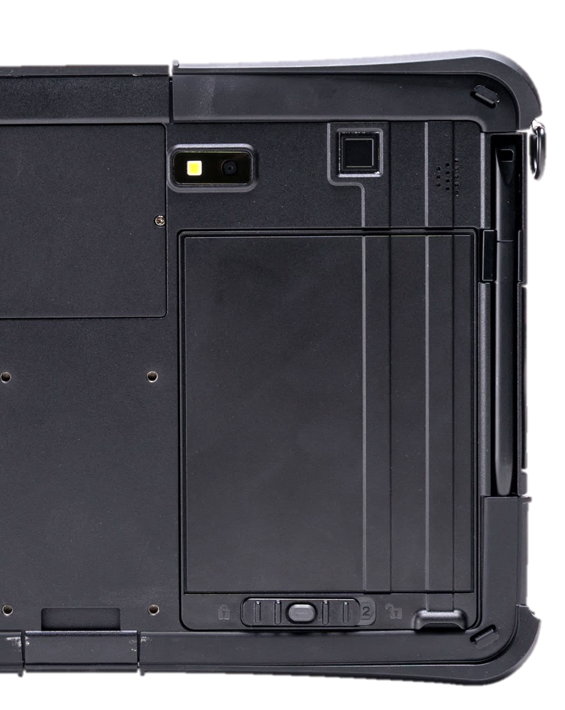
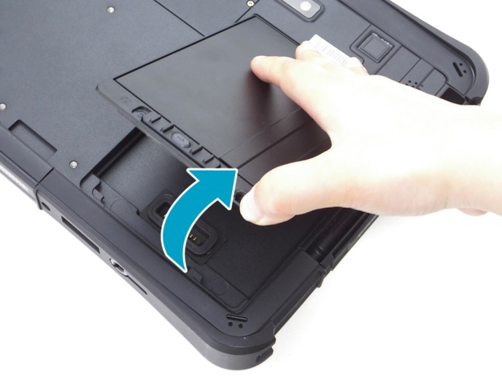
NON-STOP MOBILITY
Easy battery swappable capabilities
ONE, TWO and GO!
Work never interrupted with the friendly mechanical design for easy battery swappable capabilities and full protection that minimize the working downtime.
Step 2
Step 1

Slide 16




UNINTERRUPTABLE POWER
24/7 Non-Stop Operation allow
professionals complete full-day duty tasks
DURABOOK U11I
Non-stop operation
Support up to 5 mins
swap time
Build in with energy cell on supporting non-stop operation, no downtime for battery swaps.
Bridge Battery
Main Battery
Other Market Solution
Only 1 min swap time
Shutdown system
OR
Bridge Battery
Main Battery
Too tight with highly risk to shutdown system
Main Battery

Slide 17

BATTERY CHARGING PROTECTION
To reduce battery aging, Durabook has developed four battery charging modes with enhanced charging algorithms for our customers to choose from.
4 Battery modes:
Regular Mode
In this mode the battery will be fully charged.
Optimized Battery Charging (OBC)
Battery charging will stop at 80% to reduce battery aging.
Temperature Control Mode (TCM)
To extend the lifetime of the battery, charging is
enhanced based on DURABOOK intelligent algorithm
and battery temperature.
DURA² Charging (D2C)
To maximize battery performance and lifespan, charging
is enhanced based on DURABOOK intelligent algorithm
and battery temperature. Battery charging will stop at 80%.

Slide 18
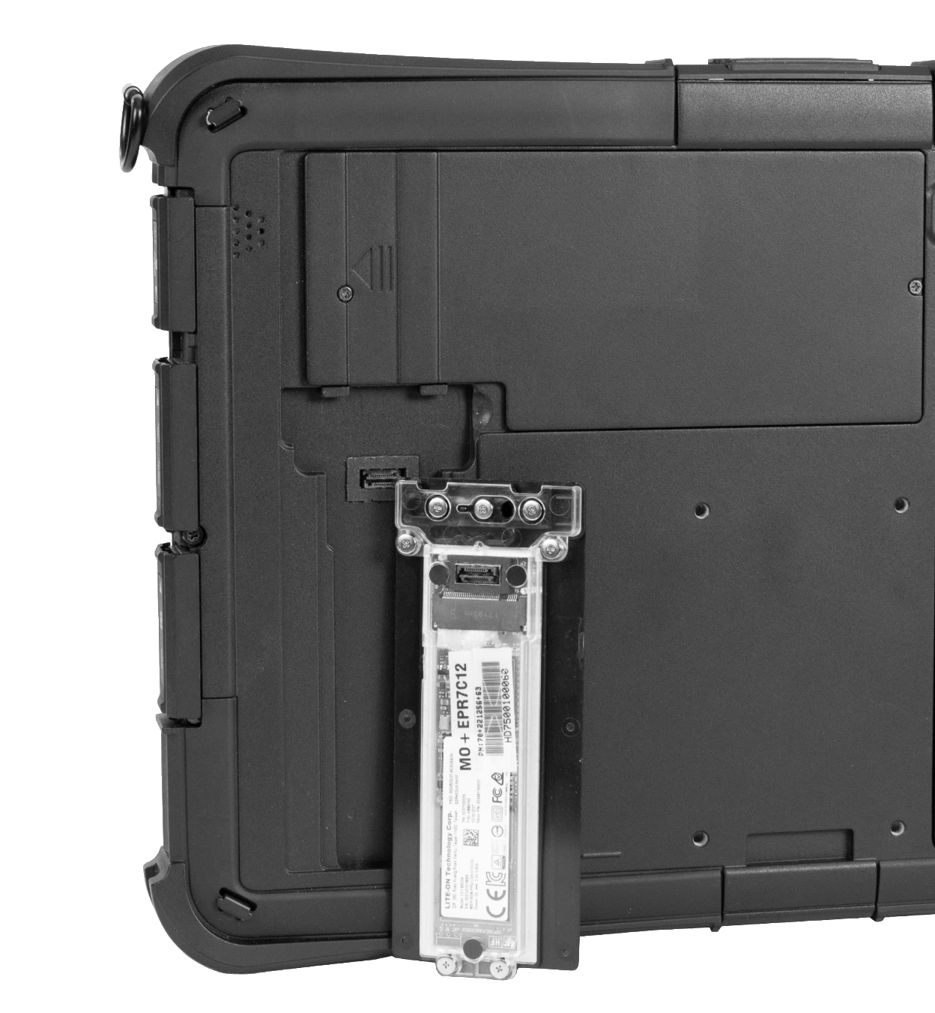
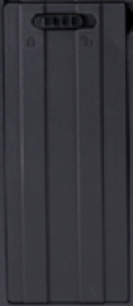
MILITARY-GRADE LEVEL SECURITY
Exclusive quick release FEATURE
Quick Release NVMe SSD
The U11I features an SSD that’s quick and easy to remove — without having to open any covers — saving you time and effort.
It is equipped with the latest NVMe PCIe SSD solution, providing up to 2TB of storage.
Step 1
Step 2

Slide 19

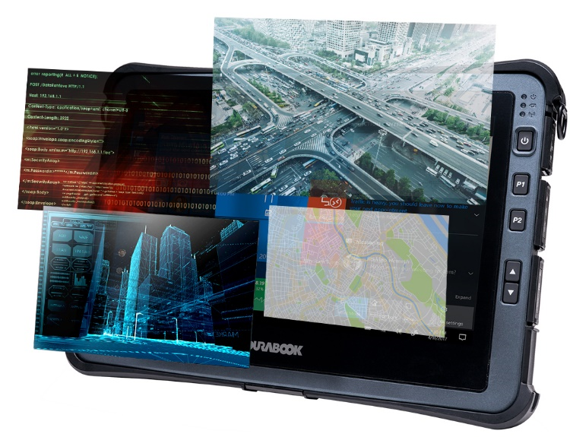



ENTERPRISE-CLASS PERFORMANCE
EXPANDABLE AND CONFIGURABLE I/O OPTIONS
The new rugged U11I offers more functional diversity than the previous model (10th Gen), reaching a new level of performance.
Features | U11I (12th Gen) | U11I (10th Gen)
USB 3.2 (Type A) | ● | ●
Thunderbolt 4 | ●
HDMI |  | ●
Audio in/out | ● | ●
Micro SD card | ● | ●
Docking connector | ● | ●
SIM card slot | ● | ●
DC in jack | ● | ●
Rear Camera | 8 MP / 5MP Windows Hello Camera | 8 MP
(with DP)
(Nano)

Slide 20

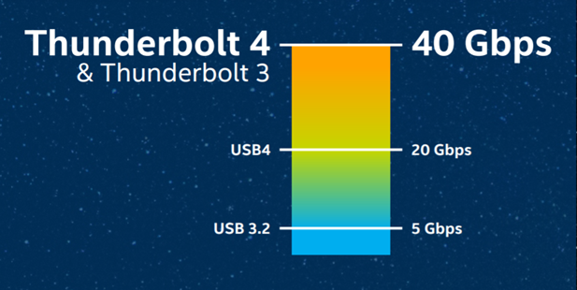
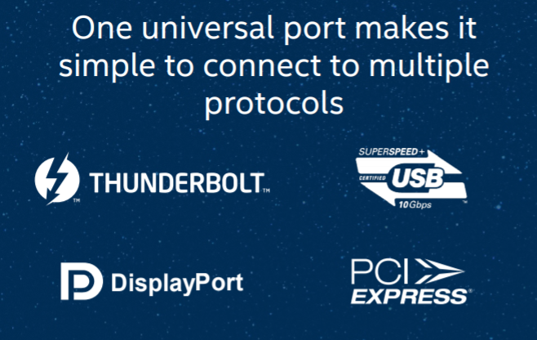
THUNDERBOLT™ 4 TECHNOLOGY
UNIVERSAL CABLE CONNECTIVITY
Thunderbolt 4 is the latest version of Intel's Thunderbolt line.
Thunderbolt 4 is more powerful and makes connecting the modern workspace more flexible and simpler than ever.
Delivers 40Gb/s of bandwidth
One port supports multiple protocols
  USB 4
  DisplayPort
  PCIe
Support up to 2x 4K external displays
It is backwards compatible with Thunderbolt 3 & USB-C
Maximum flexibility for docking station
Bi-directional power
  Power share + power delivery (PD)

Slide 21


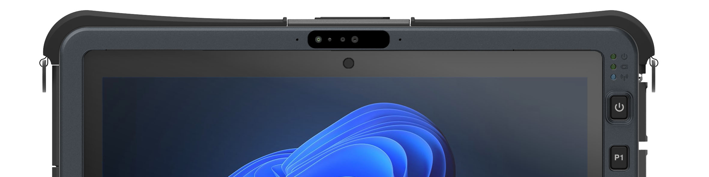
IMPROVED SECURITY WITH WINDOWS HELLO
UTILIZE the Power of biometrics-based TECHNOLOGY
U11I supports Windows Hello face authentication. The new U11I is equipped with a near infrared (IR) camera with facial recognition capability to authenticate and unlock Windows devices. Near infrared camera provides consistent image sensing capability in various ambient light environments, enabling users to login to windows securely.
Windows Hello
Face Authentication

Slide 22
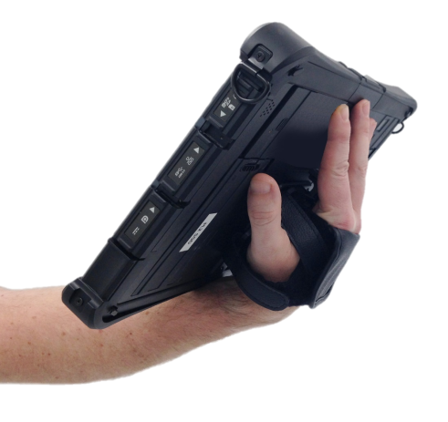






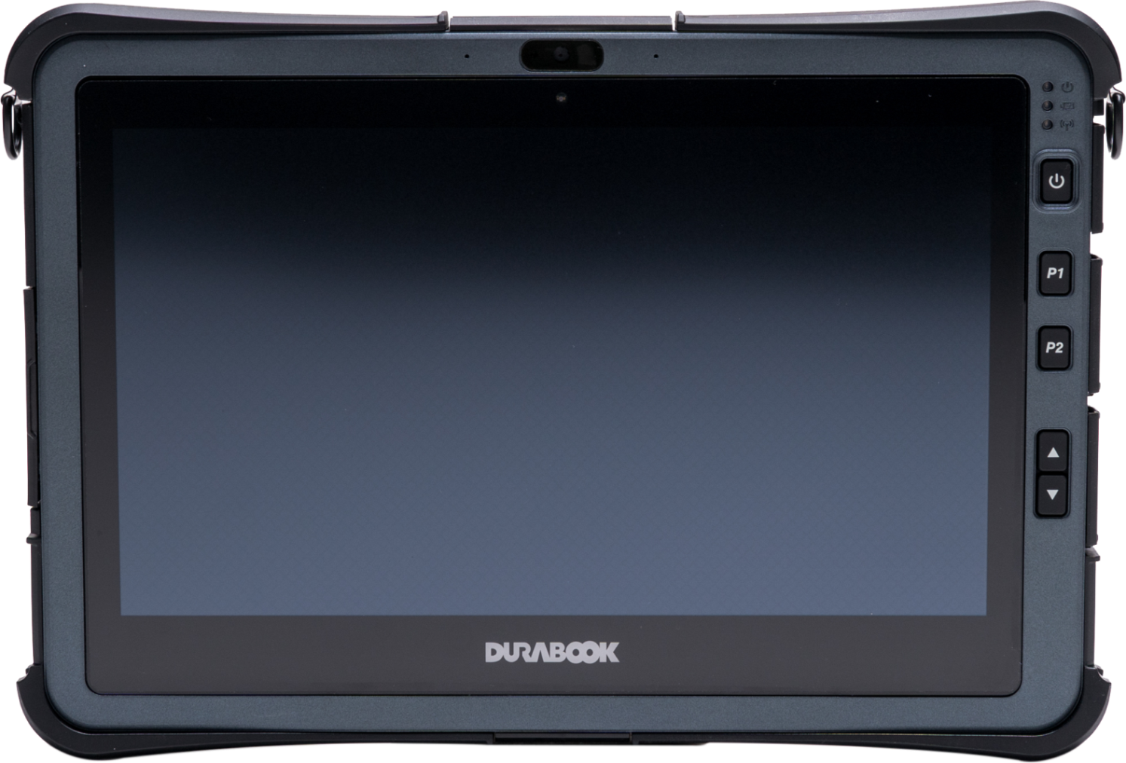


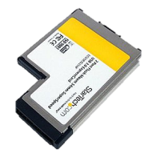





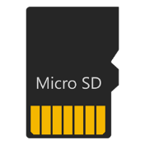
SPEAK ALL LANGUAGES
EXPANDABLE AND CONFIGURABLE I/O OPTIONS
optional
USB 3.2 Type C
Device
Expansion
USB 3.2 Type A
Device
Expansion
USB 2.0 Type A
Device Expansion
Barcode Scanner
Legacy
Device
LF/HF
RFID
RJ-45
for Data
Transfer/
Server
Legacy
Device
ExpressCard
Multiple
Devices
Thunderbolt
4
Smartcard
Data Access
Security
USB 3.2 Type A
Device Expansion
Fingerprint
Data Access
Security
4G LTE/5G
Connection
Quick data exchange

Slide 23
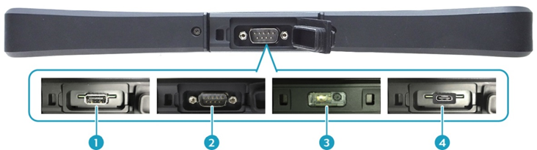

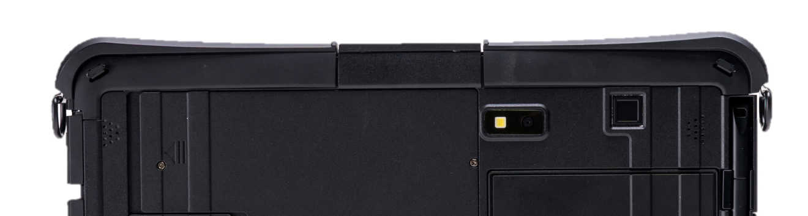
INFINITE CUSTOMIZATION 1/2
FLEXIBILITY FOR VARIOUS I/O OPTIONS
5
USB 3.2 Type A
RS-232
Barcode
Scanner
USB 3.2 Type C
USB 2.0 Type A
*Project-Based Feature
*Project-Based Feature
8MP Camera
Optional
Fingerprint Scanner

Slide 24
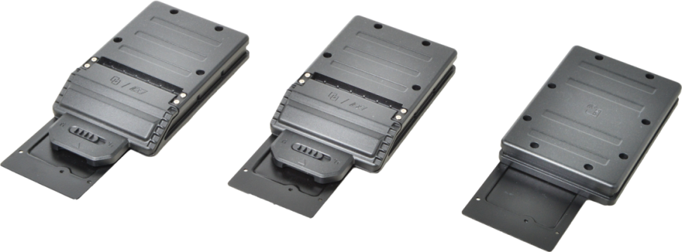
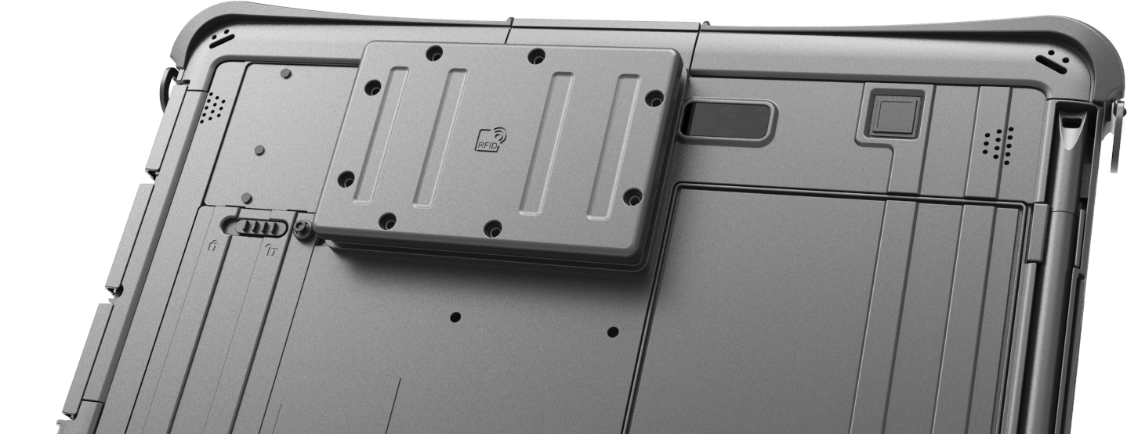
INFINITE CUSTOMIZATION 2/2
U11I offers expansion modules for enhanced flexibility:
  2nd Smart Card Reader
  ExpressCard 54 Module
  LF/HF RFID (NFC) Module
Other customized features
available by request.
3 Expansion Modules available

Slide 25
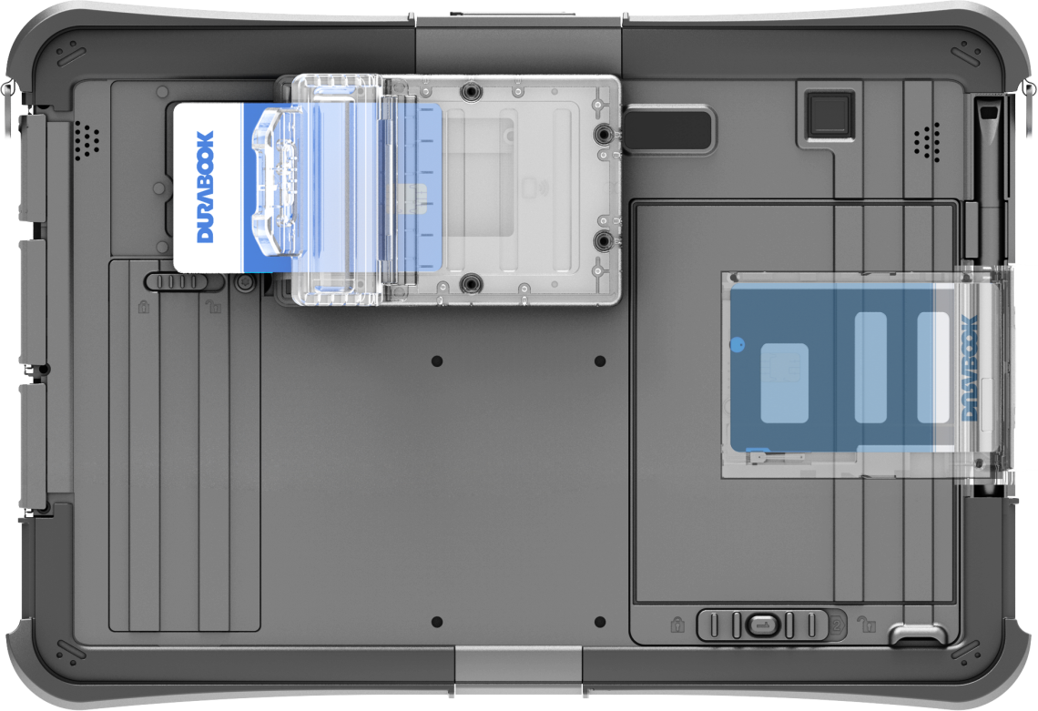
EFFICIENT EMS DEVICE
A medical-purpose born feature enables users to provide medical staff’s identification and to verify patients’ information simultaneously.
There are two expansion models available:
  2nd Smart Card Reader, or
  2nd Smart Card & RFID Reader
As an added convenience, U11I can be equipped with two smart card readers for identifications, one for medical personnel and the other for patients. Optional RFID reader can be integrated as an expansion to facilitate patient identification and records management.
Main Smart
Card Reader
(Embedded)
2nd Smart Card
Reader
(Expansion Slot)

Slide 26
MORE RUGGED THAN EVER
MIL-STD-810H certified
With excellent design know-how, the U11I is able to withstand harsher environmental challenges than ever.
U11I is MIL-STD 810H and IP66 certified (6’ Drop, Shock, Vibration, Rain, Dust, Altitude, Freeze/Thaw, High/Low Temperature, Temperature Shock, Humidity, Explosive Atmosphere, Salt Fog) MIL-STD 461G & ANSI C1D2.
Rugged Features
Durabook U11I | 6 feet drop + Salt Fog + Explosive Atmosphere + ANSI C1D2
Market Solution D | 6 feet drop + ANSI C1D2
Market Solution P
Market Solution G

Slide 27
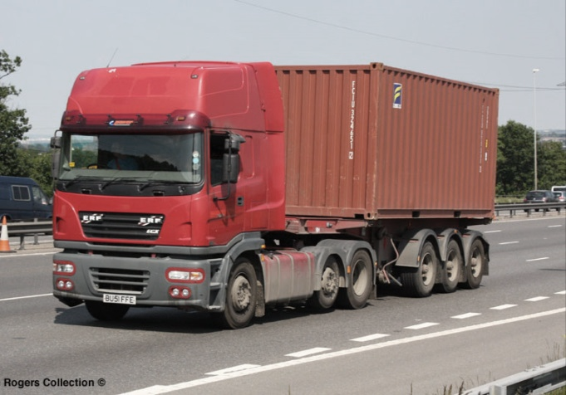

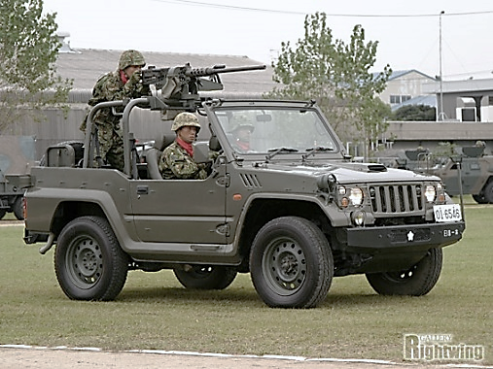
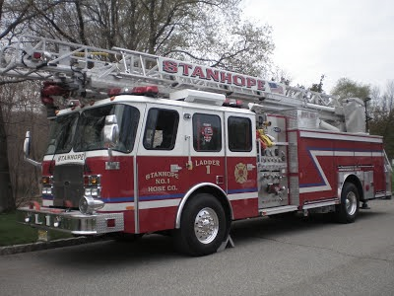

DROP RESISTANCE
BUILT TO LAST IN EVERY APPLICATIONS
LOGISTICS
ARMED VEHICLE
~5 ft height
~4.5 ft height
DURABOOK U11I
26 drops
6 ft (~183cm)
All drops performed on one unit, operating.
FIRE TRUCK
HEAVY MACHINE
~4 ft height
~6 ft height

Slide 28
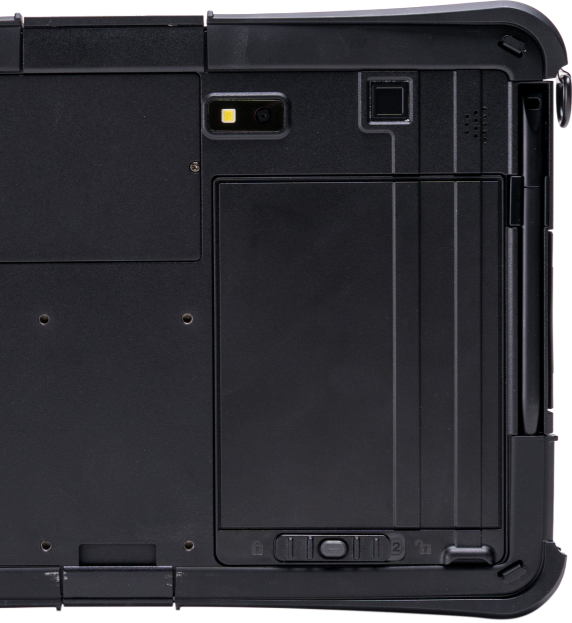
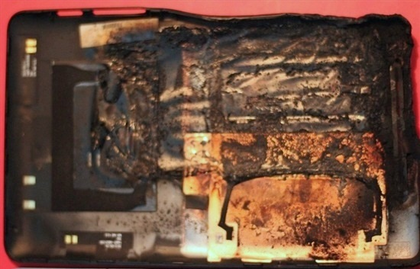

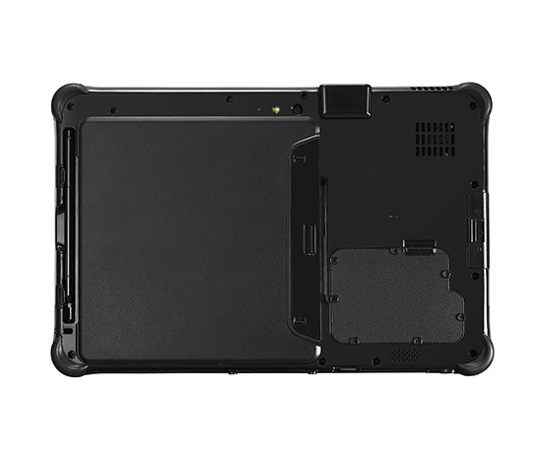
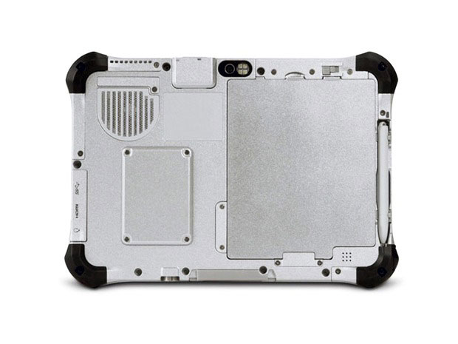

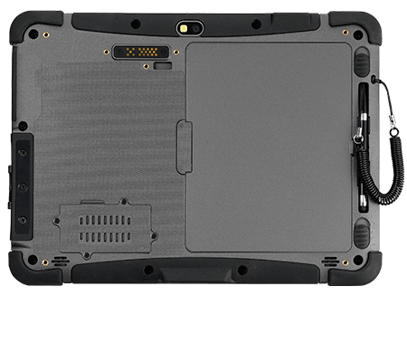

COOLFINITY™ FANLESS DESIGN
FOR THE MOST CHALLENGING ENVIRONMENTS
Zero Downtime
Fan failure is one of most common reasons lead to system overheat, and therefore damaging other components. Especially in desert environment, the fan failure rate is becoming higher.
COOLFINITY™ fanless design also means free-of-noise. In some user scenarios, such as battlefield, hospital and stealth mode, every peace matters.
U11I provides best performance with
better thermal in a compact design.
Market Solution
Potential Failure
Acoustic Test
Durabook U11I | 0 dBA
Market Solution A/B/C | 37-40 dBA

Slide 29
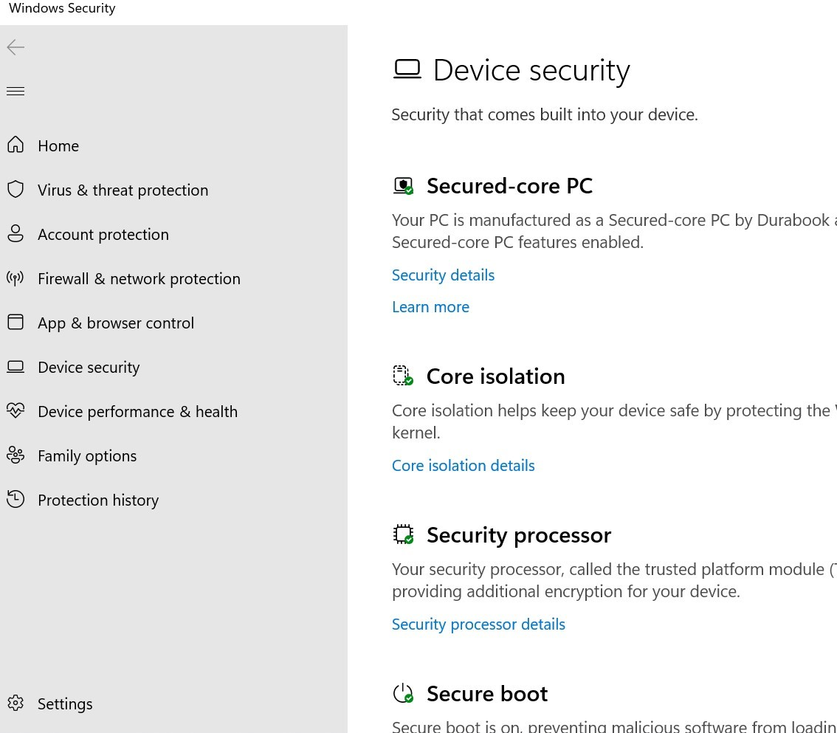
ELEVATE PROTECTION WITH SECURED-CORE PC
SupportING WINDOWS HELLO
*Secured-core PC is project base
Multifactor Authentication (MFA)
    Capacitive Fingerprint Reader
    Camera for Windows Hello facial recognition
    Smart Card reader
    LF/HF-RFID reader
Sniff out any tampering bootups
    TPM2.0 prevents tampering or malicious attacks.

Slide 30
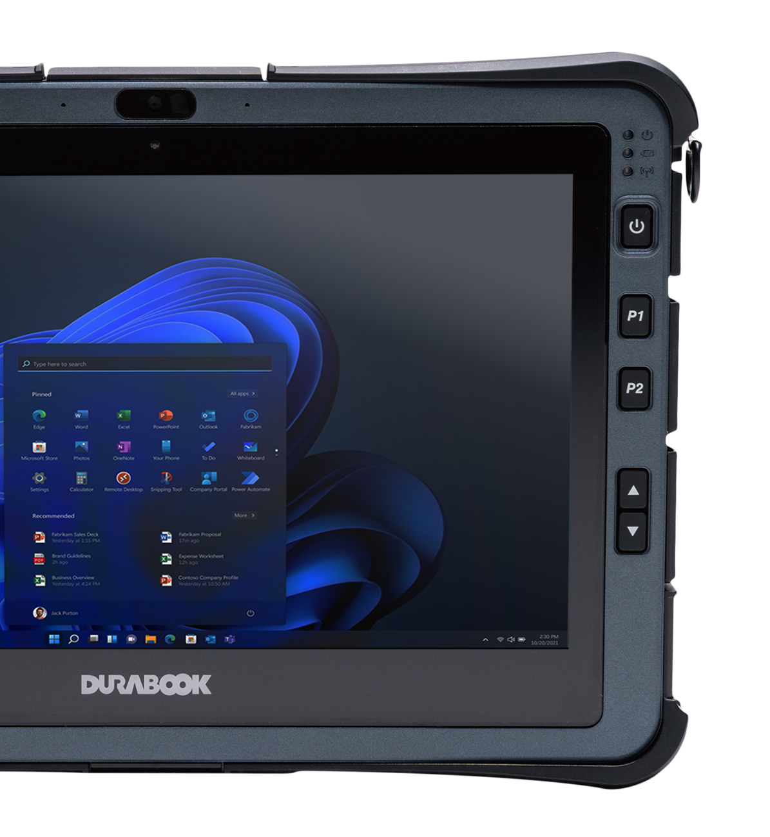
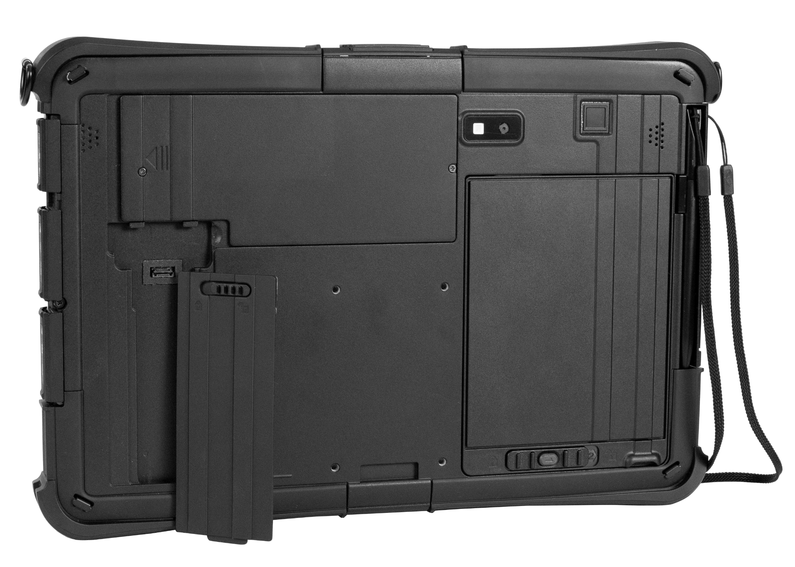
U11I ANATOMY
2MP CAMERA
OPTIONAL IR CAMERA FOR WINDOWS HELLO
FRONT
BACK
OPTIONAL BARCODE READER, USB 3.2 TYPE C/TYPE A,
USB 2.0 OR RS-232
OPTIONAL
8MP CAMERA
OPTIONAL
FINGERPRINT SCANNER
SPEAKER
SPEAKER
POWER
2x
PROGRAMMABLE KEYS
STYLUS PEN SLOT
BRIGHTNESS
VOLUME
ADJUSTMENT
QUICK
RELEASE
SSD
DOCKING CONNECTOR
HOT-SWAPPABLE
BATTERY PACK

Slide 31
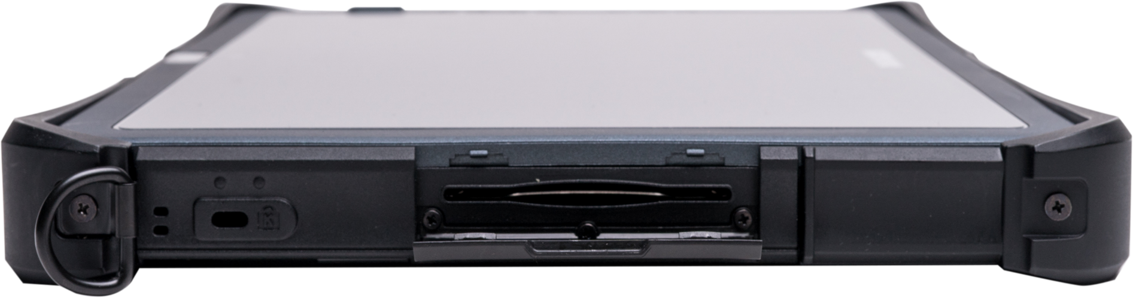
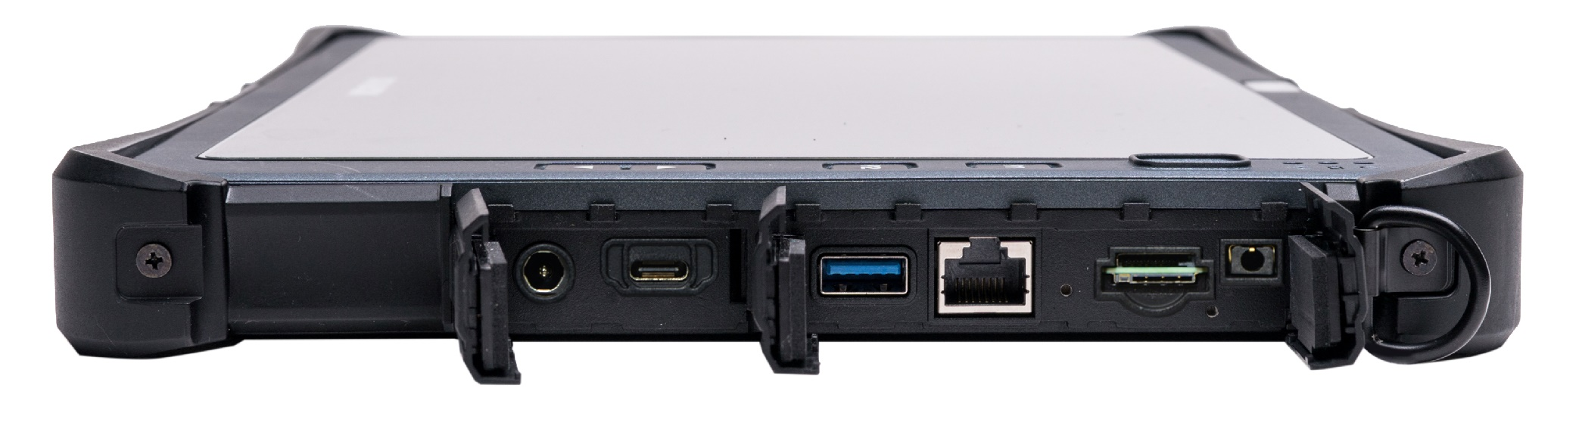
U11I ANATOMY
LEFT
RIGHT
MICRO SD
MIC / HEADSET COMBO JACK
RJ-45
NANO SIM CARD
KENSINGTON LOCK
OPTIONAL SMARTCARD / CAC READER
USB 3.2 GEN 1 TYPE A
THUNDERBOLT 4
DC-IN

Slide 32
 | U11I NEW | U11I
DURABILITY | - MIL-STD-810H certified - 6’ drops, IP 66 certified - Temperature Operating : -20°C ~ 60°C | - MIL-STD-810H certified - 6’ drops, IP 65 certified - Temperature Operating : -20°C ~ 60°C
PROCESSORS | 12th Generation Intel® Core™ - Intel® Core™ i7-1250U (12th Gen) Processor with vPro™ (12M Cache, up to 4.7 GHz, 2P+8E cores) - Intel® Core™ i5-1230U (12th Gen) Processor with vPro™ (12M Cache, up to 4.4 GHz, 2P+8E cores) | 10th Generation Intel® Core™ - Intel Core i7-10510Y, 8MB Smart Cache, 1.2 GHz - 4.5GHz Processor - Intel Core i5-10310Y, 6MB Smart Cache, 1.1 GHz - 4.1GHz Processor - Intel Core i5-10210Y, 6MB Smart Cache, 1.0 GHz - 4.0GHz Processor
GRAPHICS | Intel® Iris® Xe Graphics | Intel® UHD Graphics
MEMORY | 8GB up to 32GB (LPDDR4x) | 8GB up to 16GB (1866MHz DDR3)
STORAGE | 256GB NVME PCIE SSD - Optional 512GB/1TB/2TB PCIE SSD - Optional OPAL 2.0 SSD | 128GB NVME PCIE SSD - Optional 256GB/512GB/1TB PCIE SSD - Optional OPAL 2.0 SSD
DISPLAY | 11.6” FHD (1920 x1080) | 11.6” FHD (1920 x1080)
I/O INTERFACE | - Thunderbolt 4 x 1 - USB 3.2 Gen1 (type A) x 1 - Audio in/out (combo jack) x 1 - microSD card (microSDHC, microSDXC) x 1 - 10/100/1000 Ethernet (RJ45) x 1 - Docking connector (20-pin Pogo) x 1 - Nano SIM card x 1 - DC-In jack x 1 - Optional smart card reader x 1 or 2 - Optional serial port (RS232, 422 and 485 : D-sub,9-pin) x 1 or USB 3.2 Gen 2 (type C) x 1 or 2nd USB 3.2 Gen1 (type A) x 1 or USB 2.0 (type A) x 1 or 1D/2D barcode reader x 1 - Optional RF antenna pass-through for GPS, WWAN, and WLAN | - USB 3.1 Gen1 Type A x 1 - 2nd USB 3.1 Gen1 Type A x 1 - Audio in/out (combo jack) x 1 - microSD card (microSDHC, microSDXC) x 1 - 10/100/1000 Ethernet (RJ-45) x 1 - HDMI port (type A) x 1 - Docking Connector (20-pin Pogo) x 1 - SIM card x 1 - Optional Smart card reader x 1 or 2 - DC-in jack x 1 - Optional RF antenna pass-through for GPS, WWAN, and WLAN
MODULES | Optional ExpressCard 54, RFID or 2nd smart card reader | Optional PCMCIA Type II, ExpressCard 54, RFID or 2nd smart card reader
DIMENSION & WEIGHT | - 317 mm (L) x 215 mm (W) x 23.8 mm (H) - 1.39 kg | - 317 mm (L) x 215 mm (W) x 23.8 mm (H) - 1.39 kg

Slide 33
 | DURABOOK U11I | Market Solution G (F110) | Market Solution G (UX10) | Market Solution P (TOUGHBOOK G2) | Market Solution Z (L10)
Drop | MIL-STD-810H, 6’ drop | MIL-STD-810H, 6' drop | MIL-STD-810H, 6' drop | MIL-STD-810H, 4' drop | MIL-STD-810G, 6' drop (Plywood)
IP rating | IP66 | IP66 | IP65 | IP65 | IP65
Display | 11.6” FHD (1920 x1080) - Optional 1000 nits DynaVue® sunlight readable display with capacitive multi-touch screen or with digitizer - User selectable touch mode for Finger/Water, Glove, or Stylus programmable function | 11.6” FHD (1920 x 1080) with 1000 nits LumiBond® display with sunlight readable technology, capacitive multi-touch screen | 10.1” WUXGA (1920 ×1200) with 1000 nits LumiBond® display with sunlight readable technology, capacitive multi-touch screen | 10.1" WUXGA (1920 ×1200) with 1000 nits capacitive gloved multi touch | 10.1" WUXGA (1920 ×1200) with 1000 nits capacitive gloved multi touch
CPU | 12th Generation Intel® Core™ - Intel® Core™ i7-1250U (12th Gen) Processor with vPro™ (12M Cache, up to 4.7 GHz, 2P+8E cores) - Intel® Core™ i5-1230U (12th Gen) Processor with vPro™ (12M Cache, up to 4.4 GHz, 2P+8E cores) | 11th Generation Intel® Core™ - Intel® Core™ i5-1135G7 (up to 4.2 GHz) - Intel® Core™ i5-1145G7 vPro™(up to 4.4 GHz) - Intel® Core™ i7-1165G7 (up to 4.7 GHz) - Intel® Core™ i7-1185G7 vPro™(up to 4.8 GHz) | 10th Generation Intel® Core™ - Intel® Core™ i5-10210U (up to 4.2 GHz) - Intel® Core™ i5-10310U vPro™(up to 4.4 GHz) - Intel® Core™ i7-10510U (up to 4.9 GHz) - Intel® Core™ i7-10610U vPro™(up to 4.9 GHz) | 10th Generation Intel® Core™ - Intel® Core™ i5-10310U vPro™ (up to 4.4 GHz) - Intel® Core™ i7-10810U vPro™(up to 4.9 GHz) | 8th Generation Intel® Core™ i7 – 8650U vPro™ (up to 4.20 GHz) Intel® Core™ i5 – 8350U vPro™ (up to 3.60 GHz) Intel® Core™ i5 – 8250U (up to 3.40 GHz) Intel® Pentium® N4200; (LPDDR4 up to 2.50 GHz)
Graphic | Intel® Iris® Xe Graphics | Intel® UHD Graphics | Intel® UHD Graphics | Intel® UHD Graphics | Intel® UHD Graphics 505
Storage | 256GB NVMe PCIe SSD - Optional 512GB/512GB/1TB/2TB PCle SSD - Optional OPAL 2.0 SSD | 256GB PCIe NVMe SSD Optional 512GB/1TB PCle NVMe SSD | 256GB PCIe NVMe SSD Optional 512GB/1TB PCle NVMe SSD | 512GB or 1TB Quick-release OPAL NVMe SSD | 128GB/256GB/ 512GB SATA SSD
RAM | 8GB up to 16GB | DDR4 8GB up to 32GB | DDR4 8GB up to 32GB | 16GB or 32 GB | 8GB LPDDR3
I/O Interface | - Thunderbolt 4 x 1 - USB 3.2 Gen1 (type A) x 1 - Audio in/out (combo jack) x 1 - microSD card (microSDHC, microSDXC) x 1 - 10/100/1000 Ethernet (RJ45) x 1 - Docking connector (20-pin Pogo) x 1 - Nano SIM card x 1 - DC-In jack x 1 - Optional smart card reader x 1 or 2 - Optional USB 3.2 Gen2 (type C) x 1 - Optional 2nd USB 3.2 Gen1 (type A) x 1 - Optional USB 2.0 (type A) x 1 - Optional serial port (RS232, 422 and 485 : D-sub,9-pin) x 1 - Optional 1D/2D barcode reader x 1 - Optional RF antenna pass-through for GPS, WWAN and WLAN | Default: Thunderbolt 4 x1, USB 3.2 Gen 2 (type A) x1, Audio in/out combo, DC in Jack, Docking connector - Optional SIM card - Optional RF Passthrough | Default: USB 3.2 Gen 2 (type A) x1, Audio in/out combo, DC in Jack, Docking connector, HDMI - Optional SIM card - Optional RF Passthrough | Default: USB C (with PD), USB A, RJ-45, Dual SIM - Optional 2nd USB A - Optional True Serial Dongle D-sub 9-pin | Default: USB 3.0 x2, USB Type-C port (USB 2.0, USB 3.0, Display Port out), Audio out combo, RJ-45 microSD card, Docking connector, Nano SIM card, DC in jack
Camera | - Integrated 2.0 MP front-facing camera - 8.0 MP auto-focus rear camera with flash - Optional Windows Hello front camera | - FHD webcam - 8M pixels auto focus rear camera - Optional Windows Hello front camera | - FHD webcam - 8M pixels auto focus rear camera - Optional Windows Hello front camera | - 8MP rear camera with autofocus with LED flash - 1080p webcam w/privacy cover & dual array mic - Optional thermal camera | 13 MP rear camera with AutoFocus; 2 MP front camera with Flash
Expansion slot | - Optional ExpressCard 54 or HF/LF-RFID (NFC) or 2nd smart card reader | - Optional smart card reader - Optional 1D/2D barcode reader or USB 2.0 port or serial port + RJ45 - Optional HF RFID or Fingerprint reader | - Optional smart card reader, or Bridge battery, or smart card reader + Bridge battery - Optional 1D/2D imager barcode reader, or Serial port, or USB 3.2 Gen 1 Type-A port, or USB 3.2 Gen 1 Type-C port, or LAN port (RJ45), or VGA port i, or HF RFID reader - Optional HF RFID or Fingerprint reader or serial port + RJ45 | - Optional smart card reader - Optional 1D/2D barcode reader - Optional 2nd USB A, 2nd LAN | - Optional 1D/2D barcode reader (XPAD only) - Optional True RS232 serial, or - Optional HDMI-In, or optional CAC / Smart Card reader, or optional UHF RFID reader (AEI)
Wireless | - Intel® Wi-Fi 6E AX211 (802.11ax) - Bluetooth® V5.3 - Optional dedicated GPS module (UBLOX-NEO-M9N) - Optional 4G LTE multi-carrier mobile broadband - Optional 5G (project based) | - Intel® Wi-Fi 6 AX201, 802.11ax - Bluetooth V5.2 - Optional 4G LTE | - Intel® Wi-Fi 6 AX200, 802.11ax - Bluetooth V5.1 - Optional 4G LTE | - Intel® Wi-Fi 6 AX201 - Bluetooth V5.1 - 4G LTE | - Intel® Dual Band Wireless AC 8265 - Bluetooth v4.2 - Optional 4G LTE
Battery | 10 hrs (up to 20 hrs) | 12 hrs | 8 hrs | 18.5hrs | 10 hrs (up to 27 hrs)
Dimension | 317 x 215 x 23.8 mm / 12.48” x 8.47” x 0.94” 1.39 Kg / 2.99 lbs | 314 x 207 x 25 mm 1.52 Kg | 276.8 x 194.5 x 23.5 mm 1.22 Kg | 279 x 188 x 23.5 mm 1.31 Kg | 280.8 x 195.2 x 22 mm 1.3 Kg

